Slide 1
App for Video Induced Emotions
Magno Alessandro: 4478234

Slide 2
Introduction
Aim: induce basic emotions such as Joy, Sadness through the presentation of short clips.
Steps of the experiment:
Register/Login
Watch/Listen the clip
Record an audio expressing his/her opinion
Record an audio reading some text
Repeat from step 2

Slide 3




Architecture
Database with user information:
Id
Name
Surname
Age
Email
Password
Storage:
Videos
Records audio

Slide 4
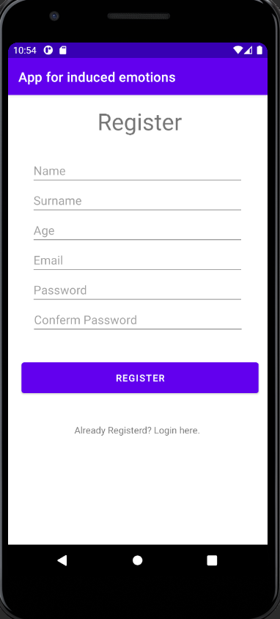
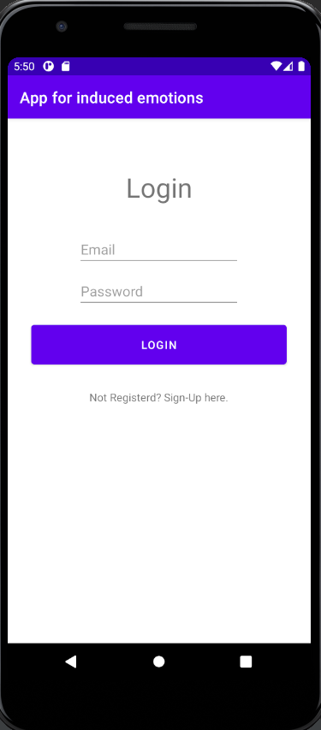
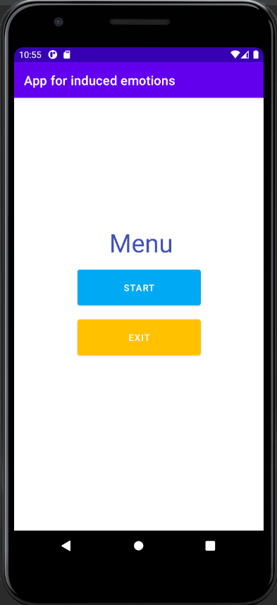
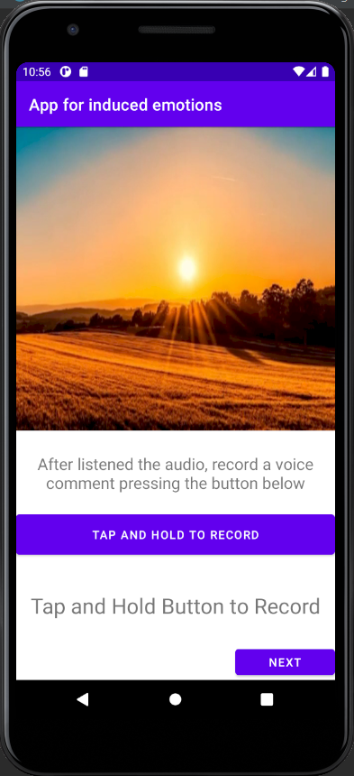
Presentation of the app

Slide 5
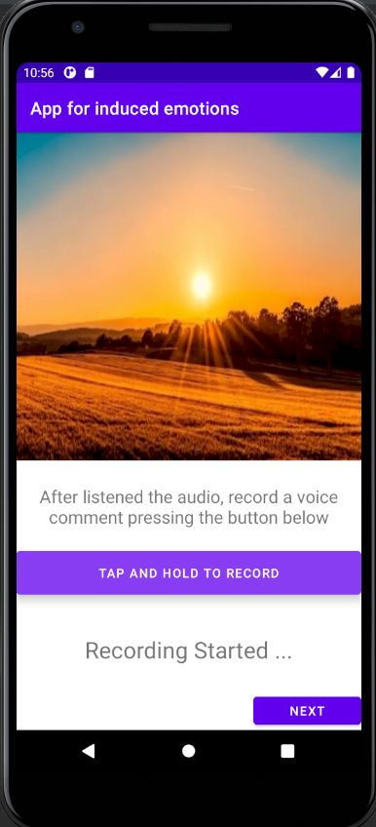
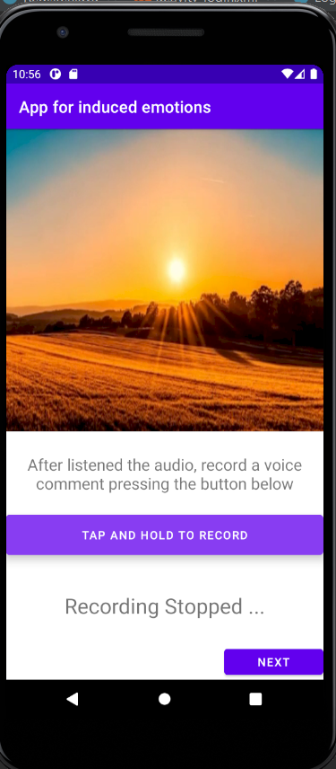
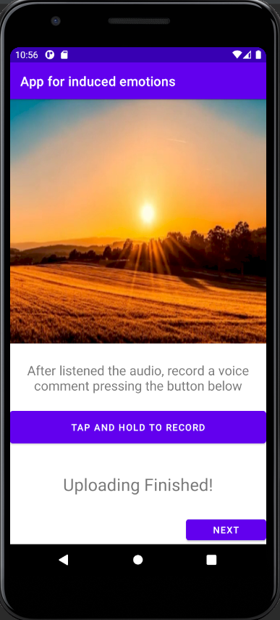
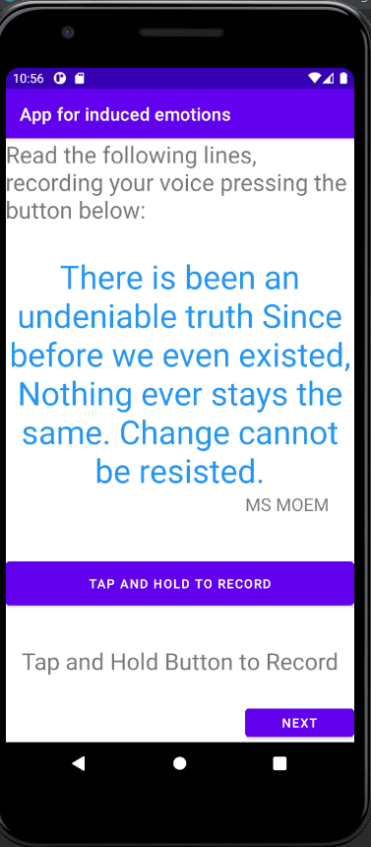
Presentation of the app

Slide 6
Conclusions
Tools used: AndroidStudio & Firebase
Effort: 44 hours

